Slide 1


Chest X-Ray Images (Pneumonia) Classification
Presenter：zhouzhou
2025.10.28

Slide 2
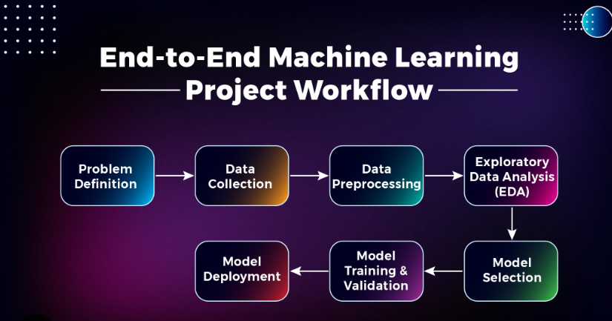
Pipeline
ML Workflow

Slide 3
01
Problem Definition

Slide 4
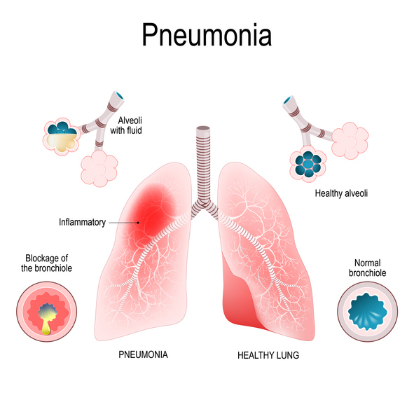
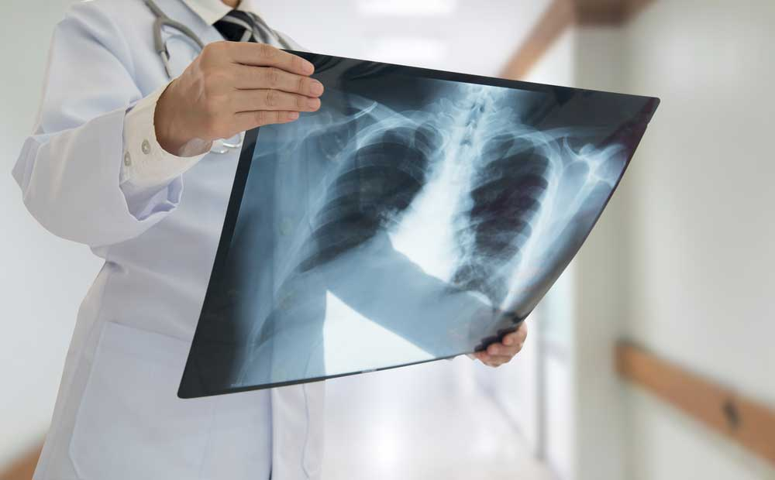
Background

Slide 5
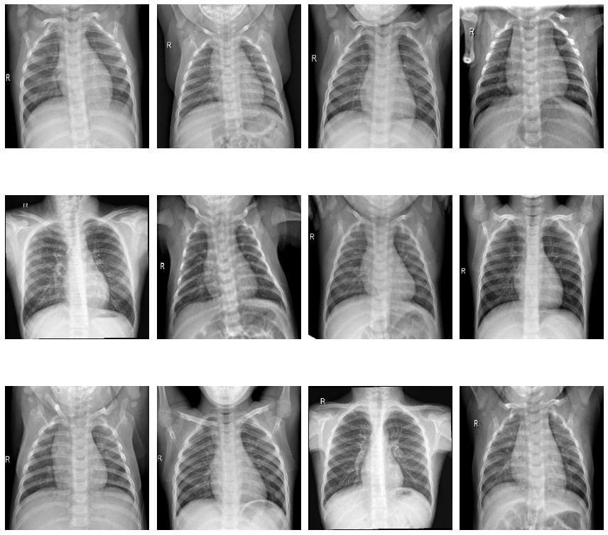
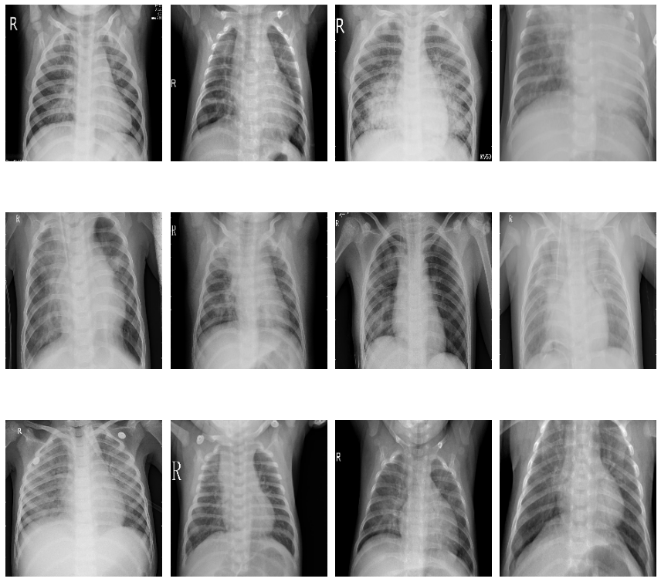
Background
Normal
Pneumonia

Slide 6
02
Chest X-Ray (Pneumonia)

Slide 7

Dataset
Chest X-ray images (AP view) were collected from pediatric patients aged 1–5 at Guangzhou Women and Children’s Medical Center
All images underwent quality control, and low-quality or unreadable scans were removed.
Diagnoses were labeled by two expert physicians, and the evaluation set was re-checked by a third expert to ensure accuracy.
The dataset is split into train / val / test subsets, each containing two classes:
Pneumonia
Normal
Due to the limited dataset size, the validation set was created by splitting the training set.

Slide 8
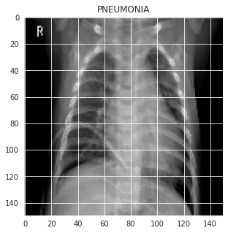
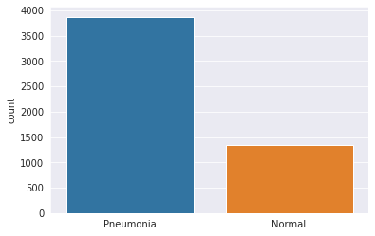
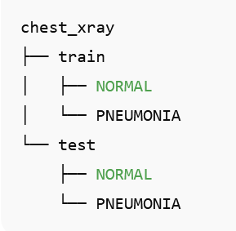
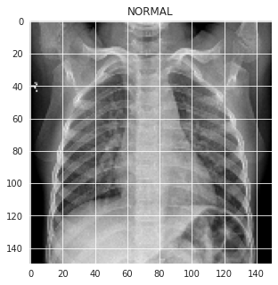
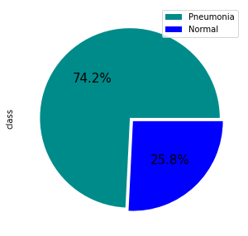
EDA
Folder structure
data visualization of train_datasets
the Normal and Pneumonia class are unbalanced

Slide 9
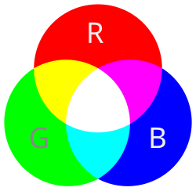
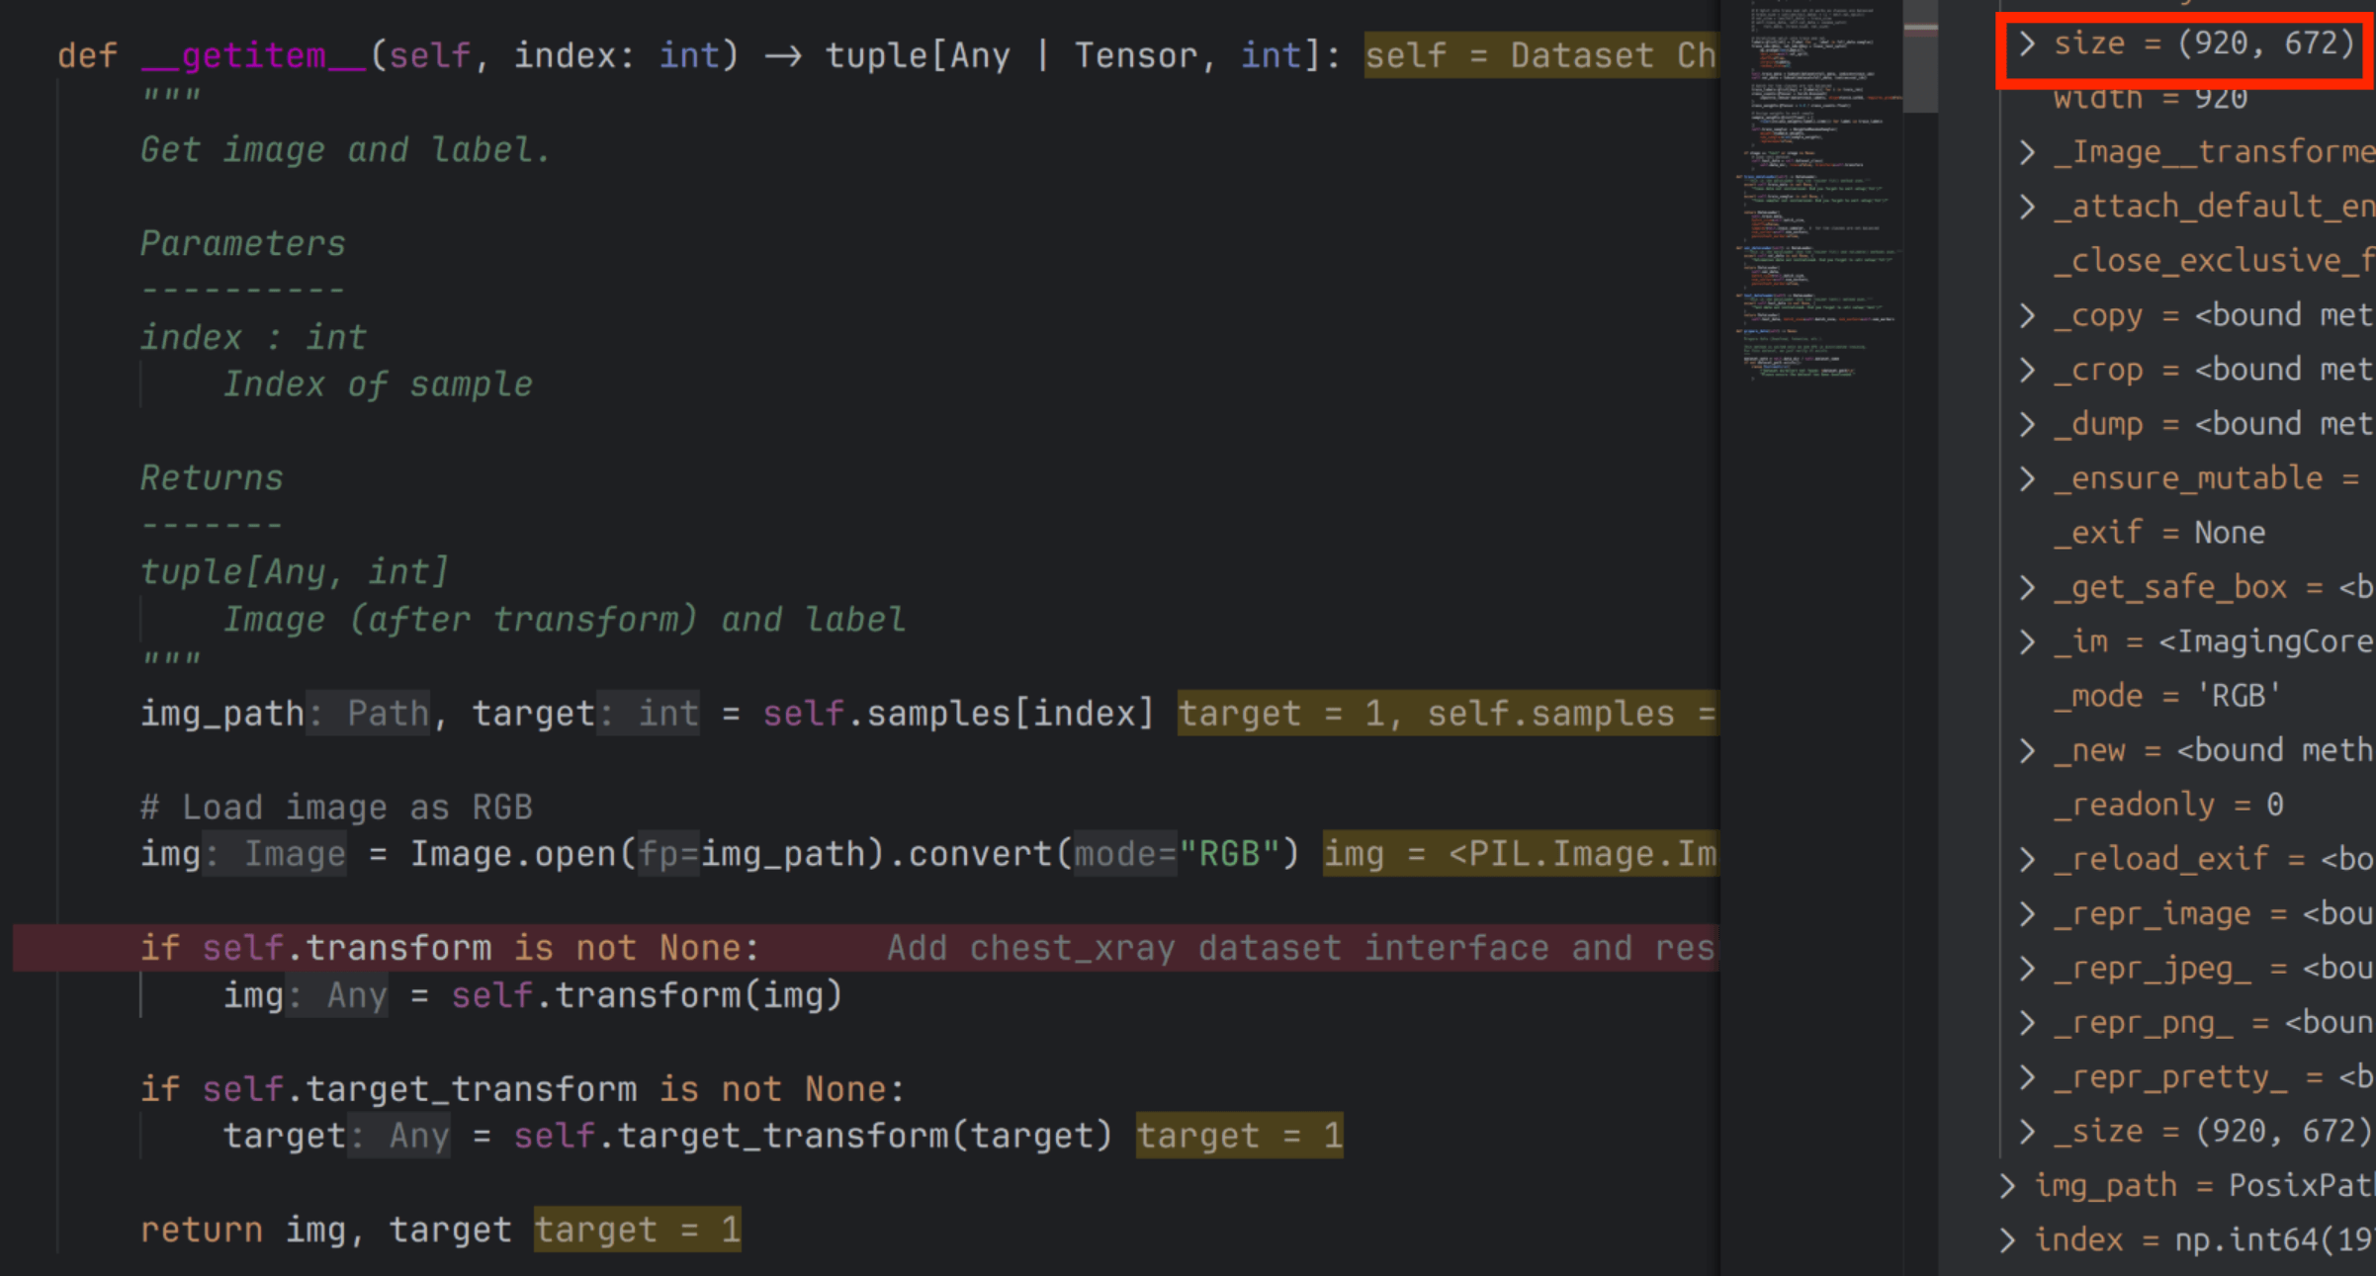
preprocess
chest x-ray dataset sample(height=672,width=920)
mode=RGB,
Dtype:unit8 in (0,255)

Slide 10
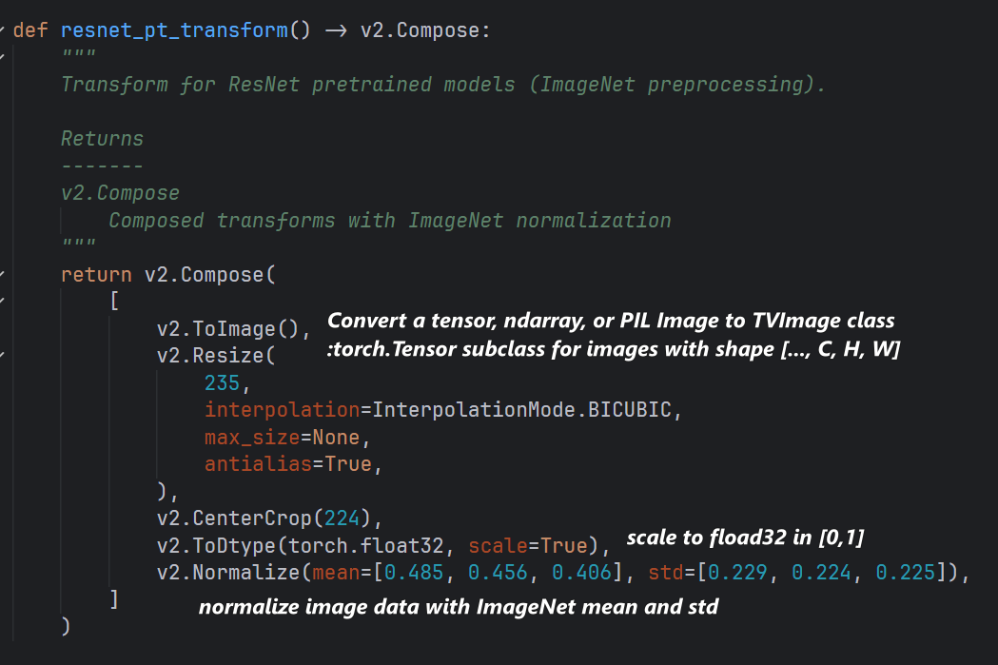
preprocess
Transformed image data (channel=3,height=224,width=224)
Dtype: float32, close to [-2,2]
PyTorch channels are placed first to maximize GPU convolution performance

Slide 11
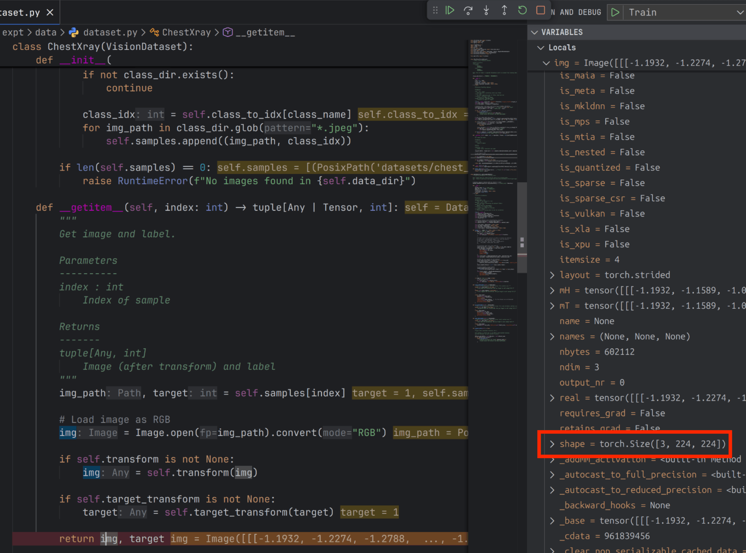
preprocess
Transformed image data (channel=3,height=224,width=224)
Dtype: float32, close to [-2,2]

Slide 12
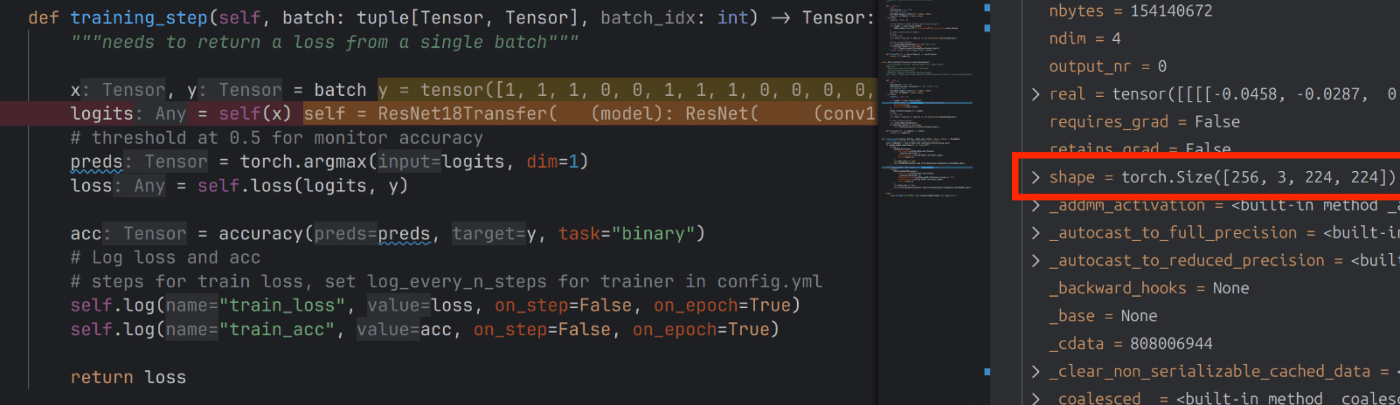
preprocess
image data in training_step (batch=256, channel=3,height=224,width=224)
The batch dimension is the number of samples sent to the GPU at one time

Slide 13
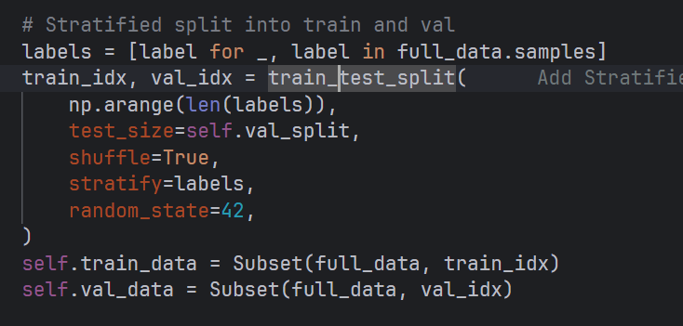
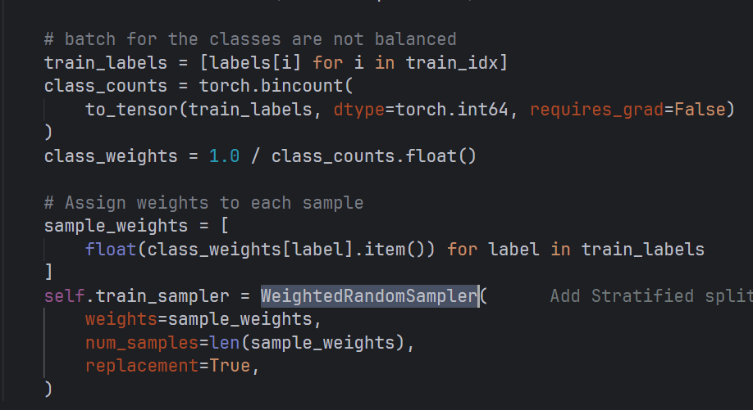
Spliting data
Train:validation datasets = 4:1
To solve the classes are unbalanced
Stratified split into train and val
WeightedRandomSampler

Slide 14
03
Model Selection

Slide 15
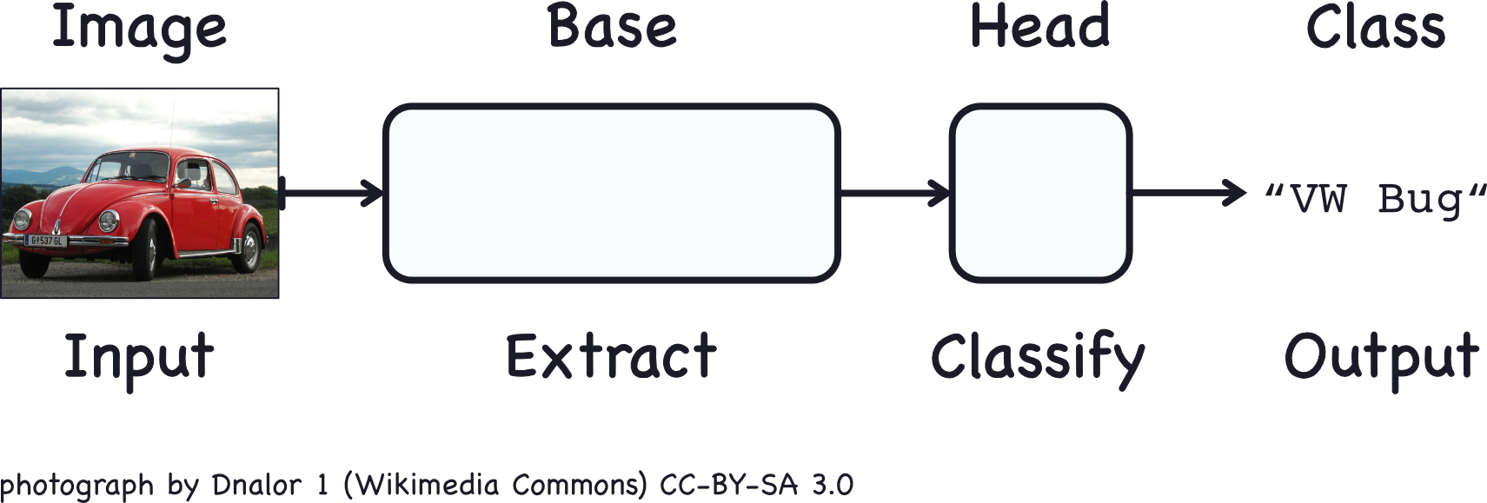
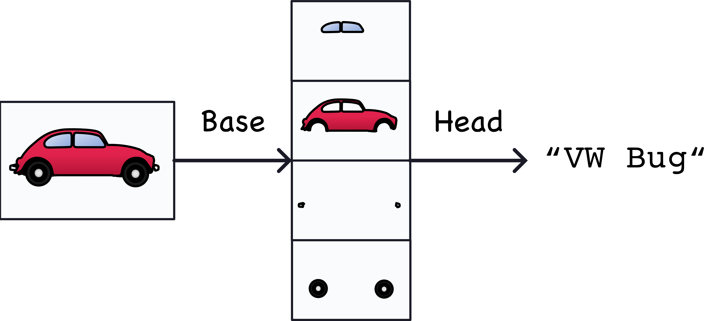
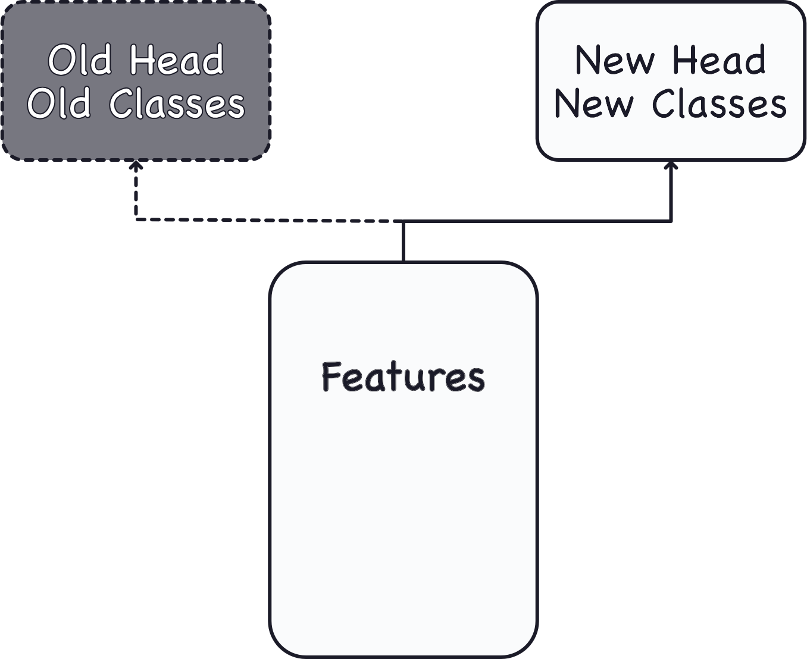
Transfer learning
Reusing a pretrained model is a technique known as transfer learning

Slide 16
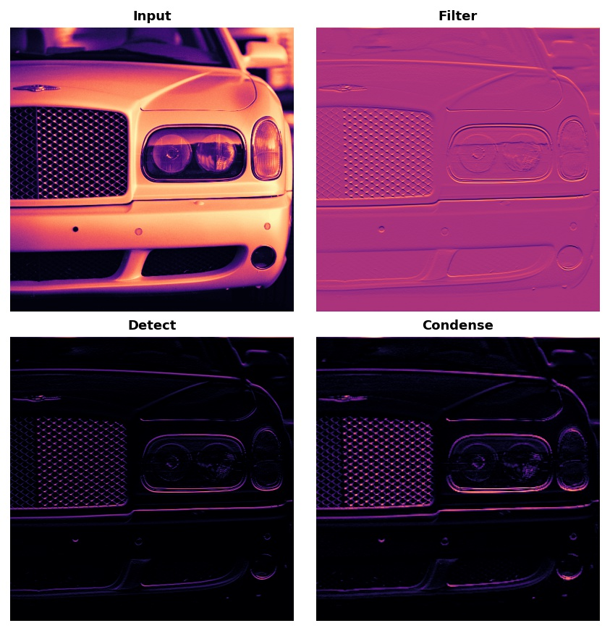
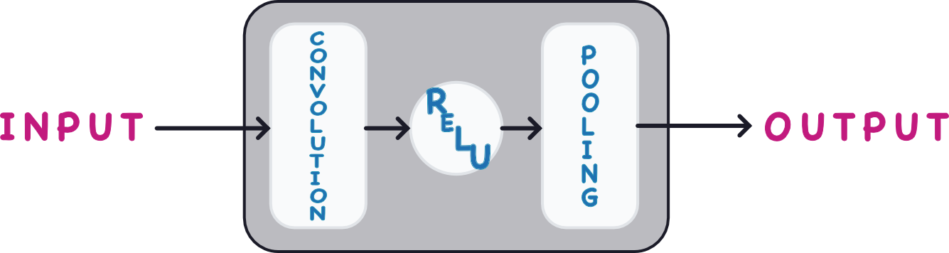
CNN
Feature Extraction in three basic operations:
Filter an image for a particular feature (convolution)
Detect that feature within the filtered image (ReLU)
Condense the image to enhance the features (maximum pooling)

Slide 17
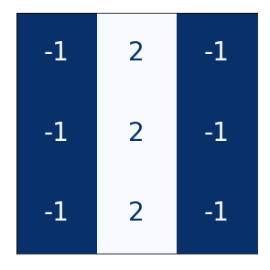
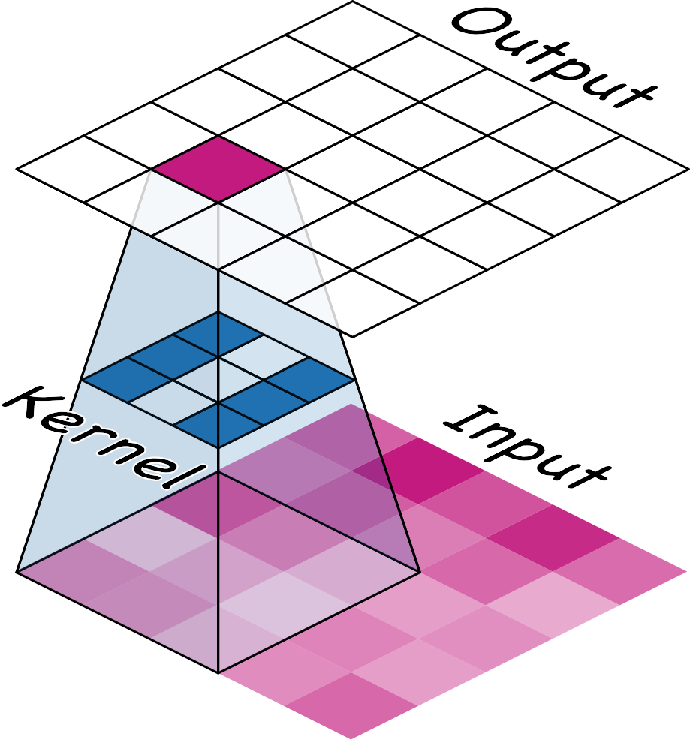
CNN
Weights
The weights a convnet learns during training are primarily contained in its convolutional layers. These weights we call kernels.
A kernel operates by scanning over an image and producing a weighted sum of pixel values
The kernels in a convolutional layer determine what kinds of features it creates
kernel_size is telling the convnet how to form these connections

Slide 18
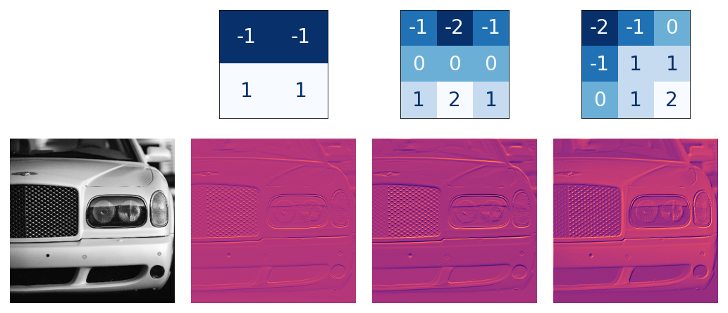
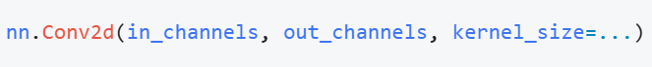
CNN
Kernels and features
When you write nn.Conv2d(in_channels, out_
PyTorch will instantiate out_channels convolutional kernels (filters),
each with a shape of (in_channels, kernel_height, kernel_width), and these kernels will be trained as parameters.

Slide 19
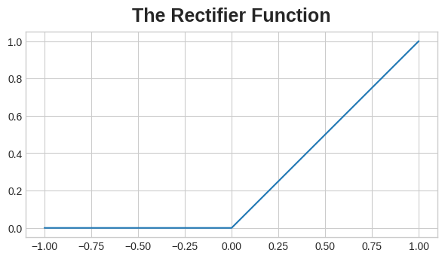
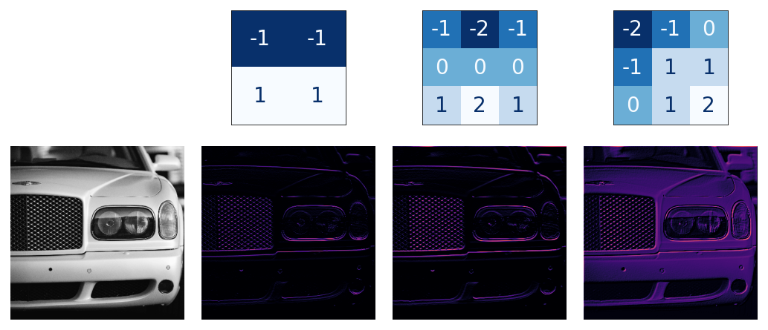
CNN
the ReLU function is nonlinear
Goals:
vanishing gradient
Sparsity (no negative output)
The differences between feature maps are greater because of 2
3 ensures features will combine in interesting ways as they move deeper into the network
Feature maps
We got feature maps from pass output of convs through the activation function

Slide 20
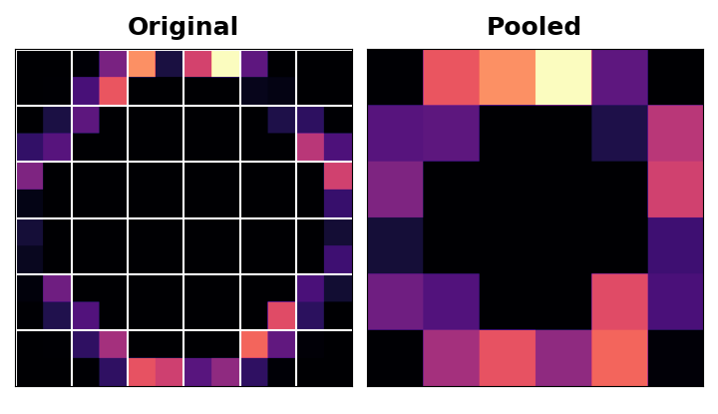
CNN
Maximum Pooling
A MaxPool2D layer is much like a Conv2D layer, except that it uses a simple maximum function instead of a kernel.
So Max pooling takes a patch of activations in the original feature map and replaces them with the maximum activation in that patch.
Goals:
Downsampling(too much 0 after ReLU)
retain only the most useful part (maximum activation)
Translation Invariance（condense after conv）

Slide 21
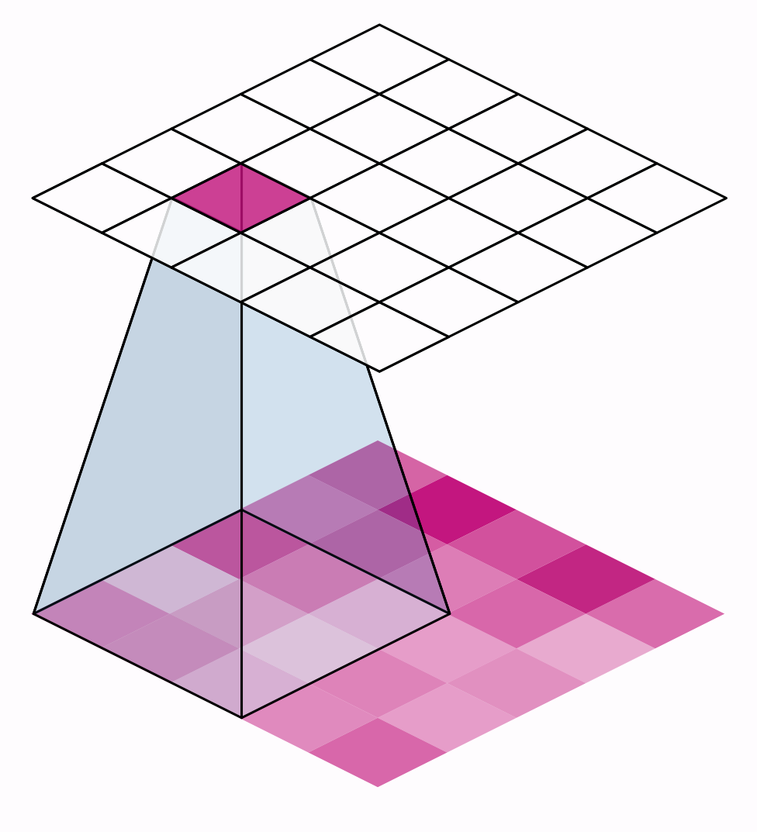
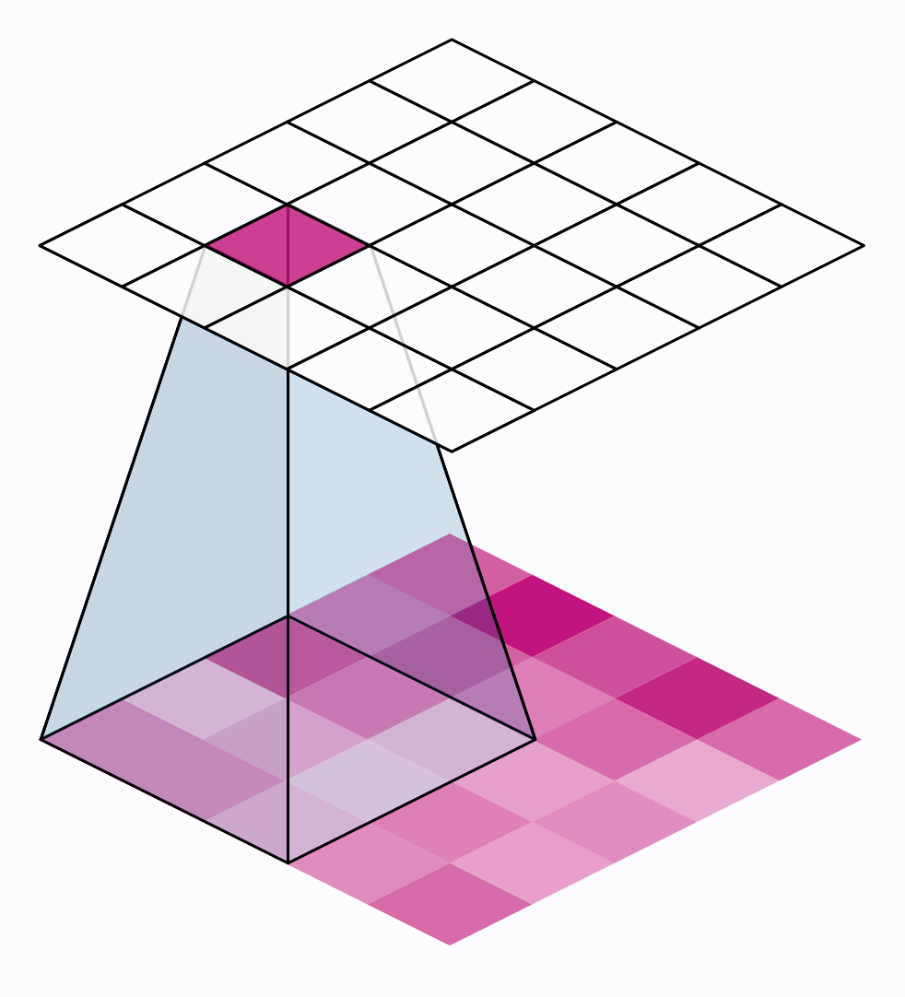
CNN
Stride
The distance the window moves at each step is called the stride
If we want high-quality features to use for classification, convolutional layers will most often have strides=(1, 1)
So Maximum pooling layers will almost always have stride values greater than 1, like (2, 2) or (3, 3), but not larger than the window itself

Slide 22
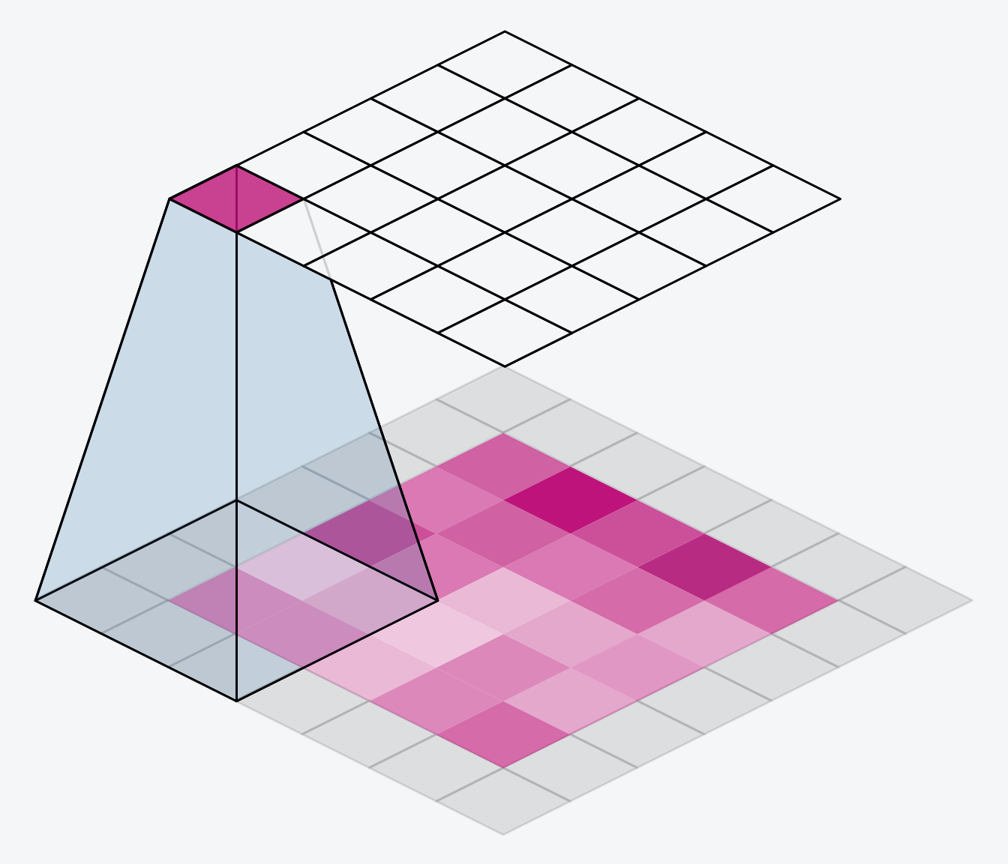
CNN
Padding
the convolution window will stay entirely inside the input if padding=0
But we do not treating all the pixels exactly the same
So adding extra pixels around the border of the feature map
And the input size equals to the output size sometimes

Slide 23
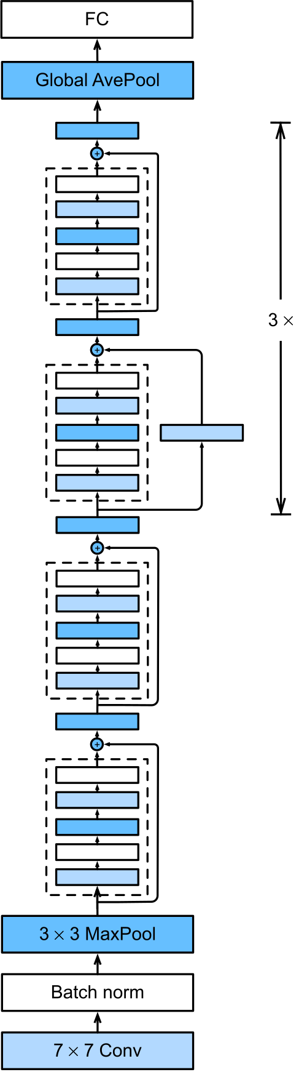
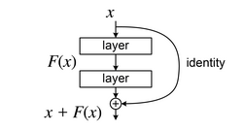
Resnet 18
The residual learning formulation provides the added benefit of mitigating the vanishing gradient problem

Slide 24
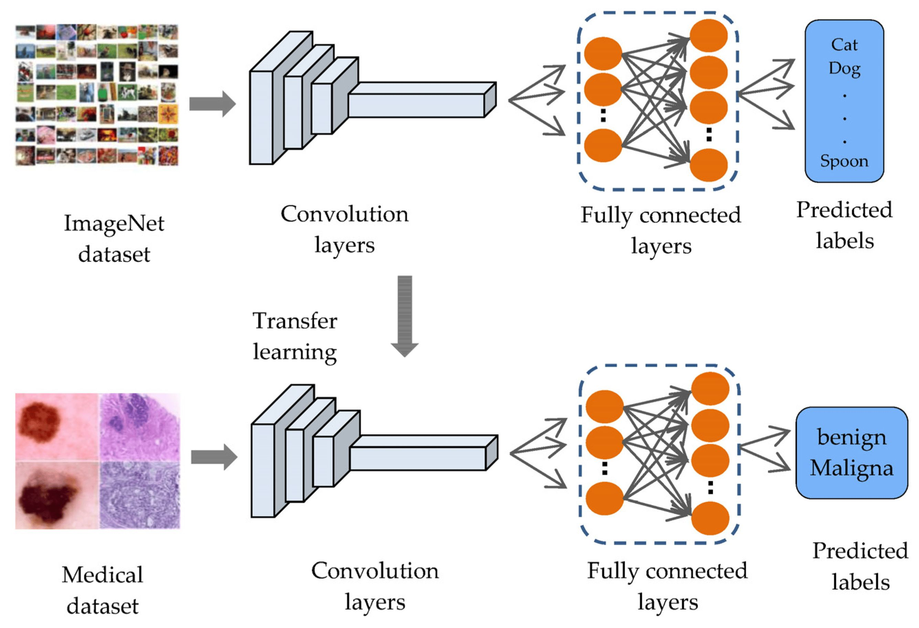
Transfer learning

Slide 25
04
Model Training/Validation/Test

Slide 26
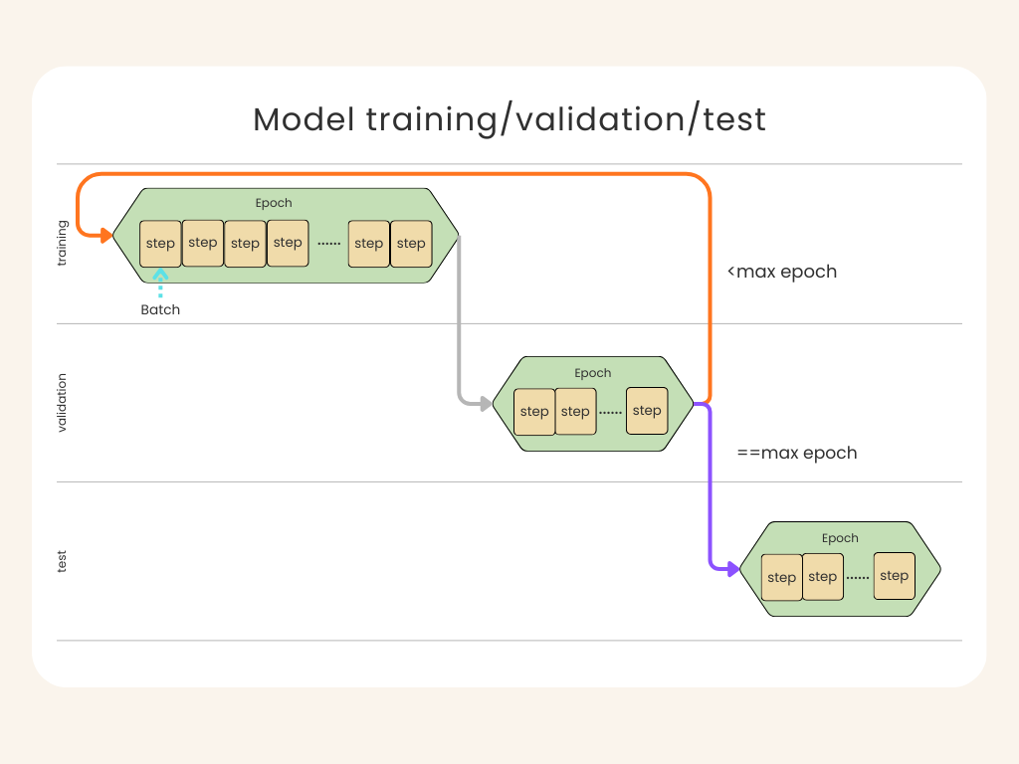
Pipeline

Slide 27
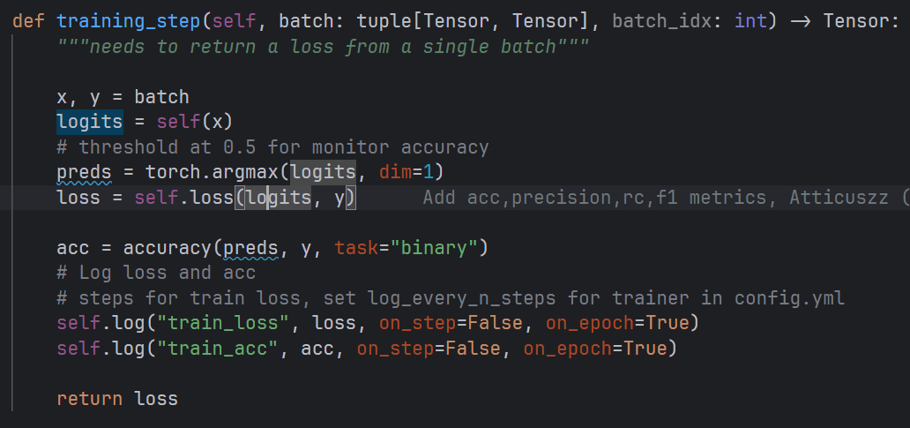
Loss Function
torch.nn.CrossEntropyLoss

Slide 28
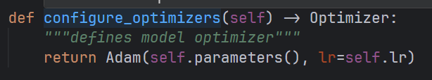
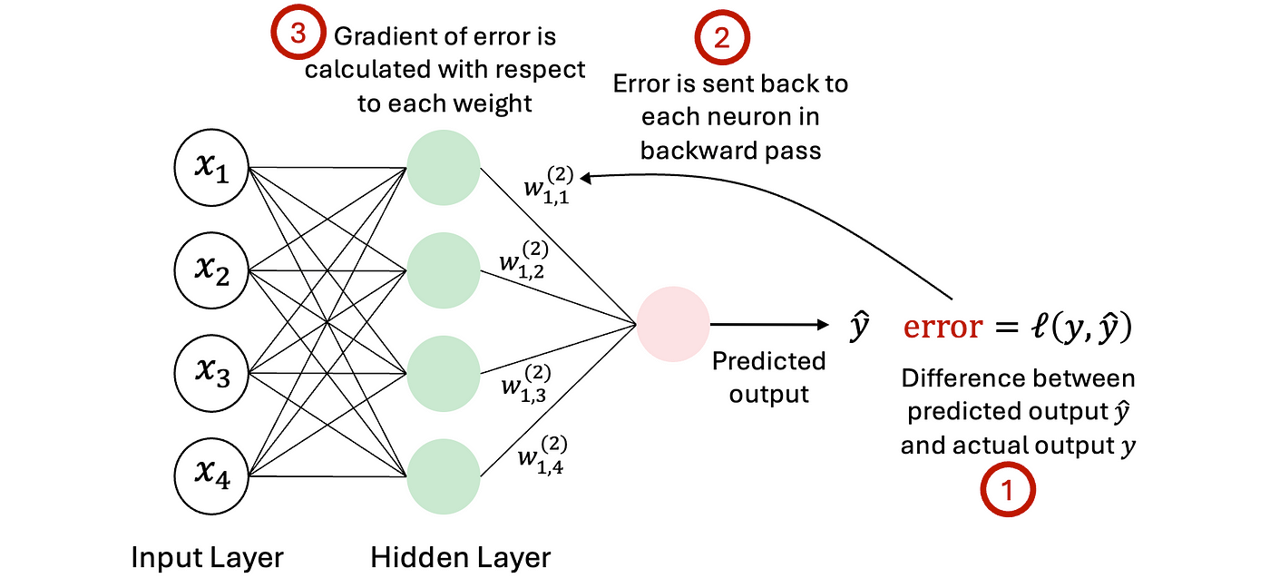
Optimization

Slide 29
05
Evaluation

Slide 30
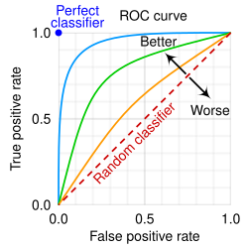
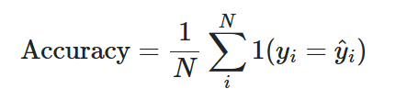
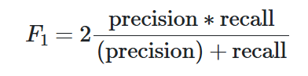
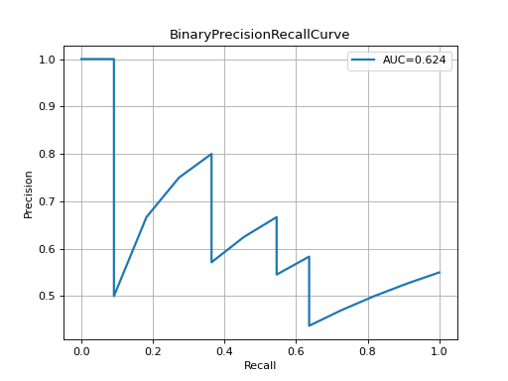
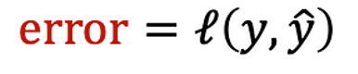
Metrics
AUROC is Area Under the Receiver Operating Characteristic Curve (ROC AUC).
The overall performance of the model at all possible thresholds
When the model must simultaneously avoid "misdiagnosis" and "missed diagnosis," and the data is imbalanced, it provides a more accurate assessment than accuracy judgment
The PR curve is the curve of precision and recall at different thresholds

Slide 31
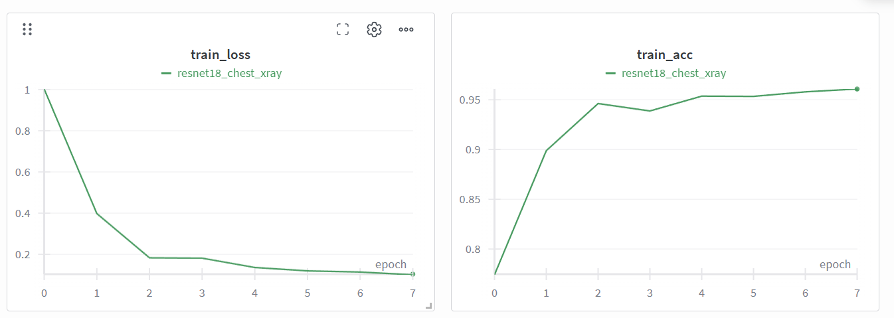
Stage Goal
Training Phase Monitoring
Focus: Stability & Convergence Status
Step-Level Monitoring:
Watch for Gradient Explosion or abnormal spikes.
Detect Oscillation (instability) to ensure smooth weight updates.
Epoch-Level Analysis:
Assess Global Convergence: Is the model actually learning?
Underfitting Indicators: If train_accuracy remains low (and close to baseline), consider:
Increasing the Learning Rate.
Extending the number of Epochs.
Logging Granularity:
Track loss on both on_step (for immediate health checks) and on_epoch (for trend analysis).

Slide 32
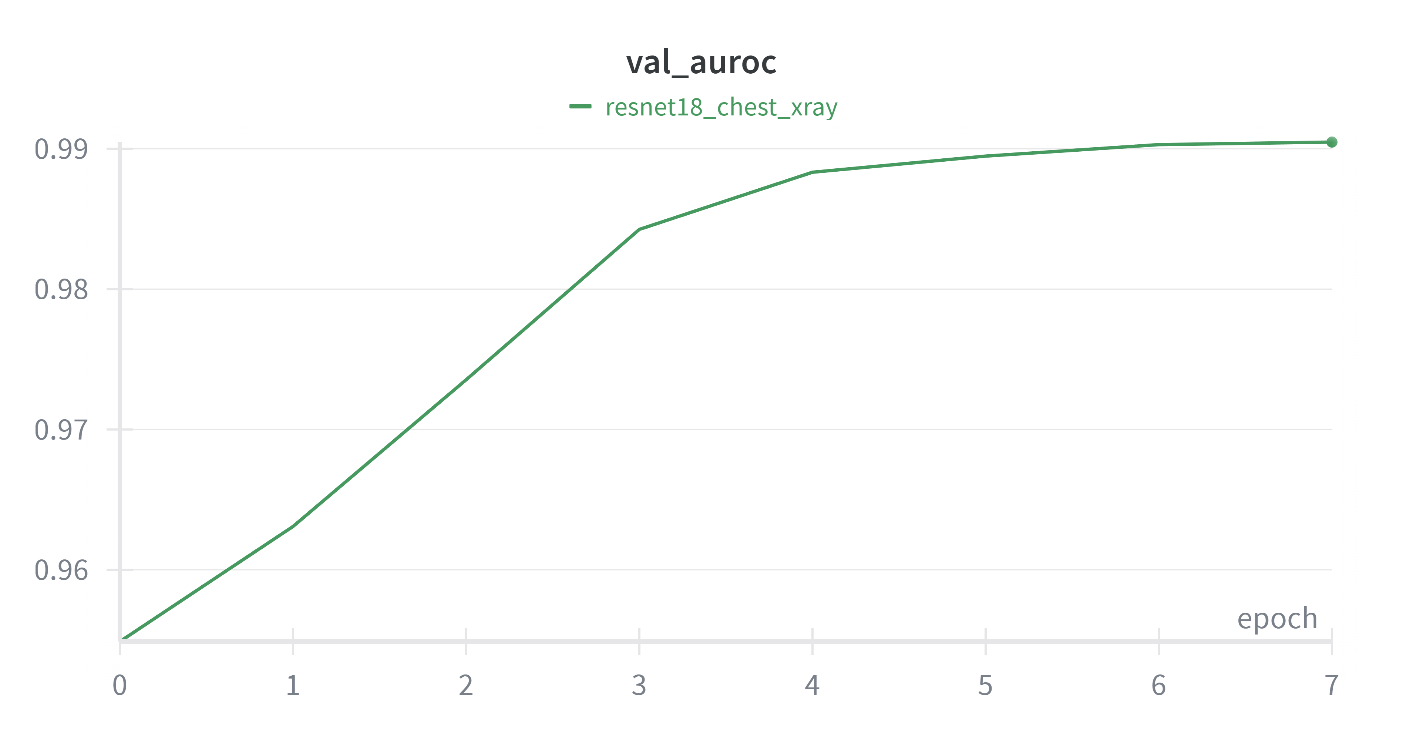
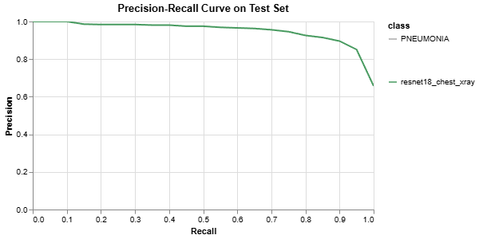
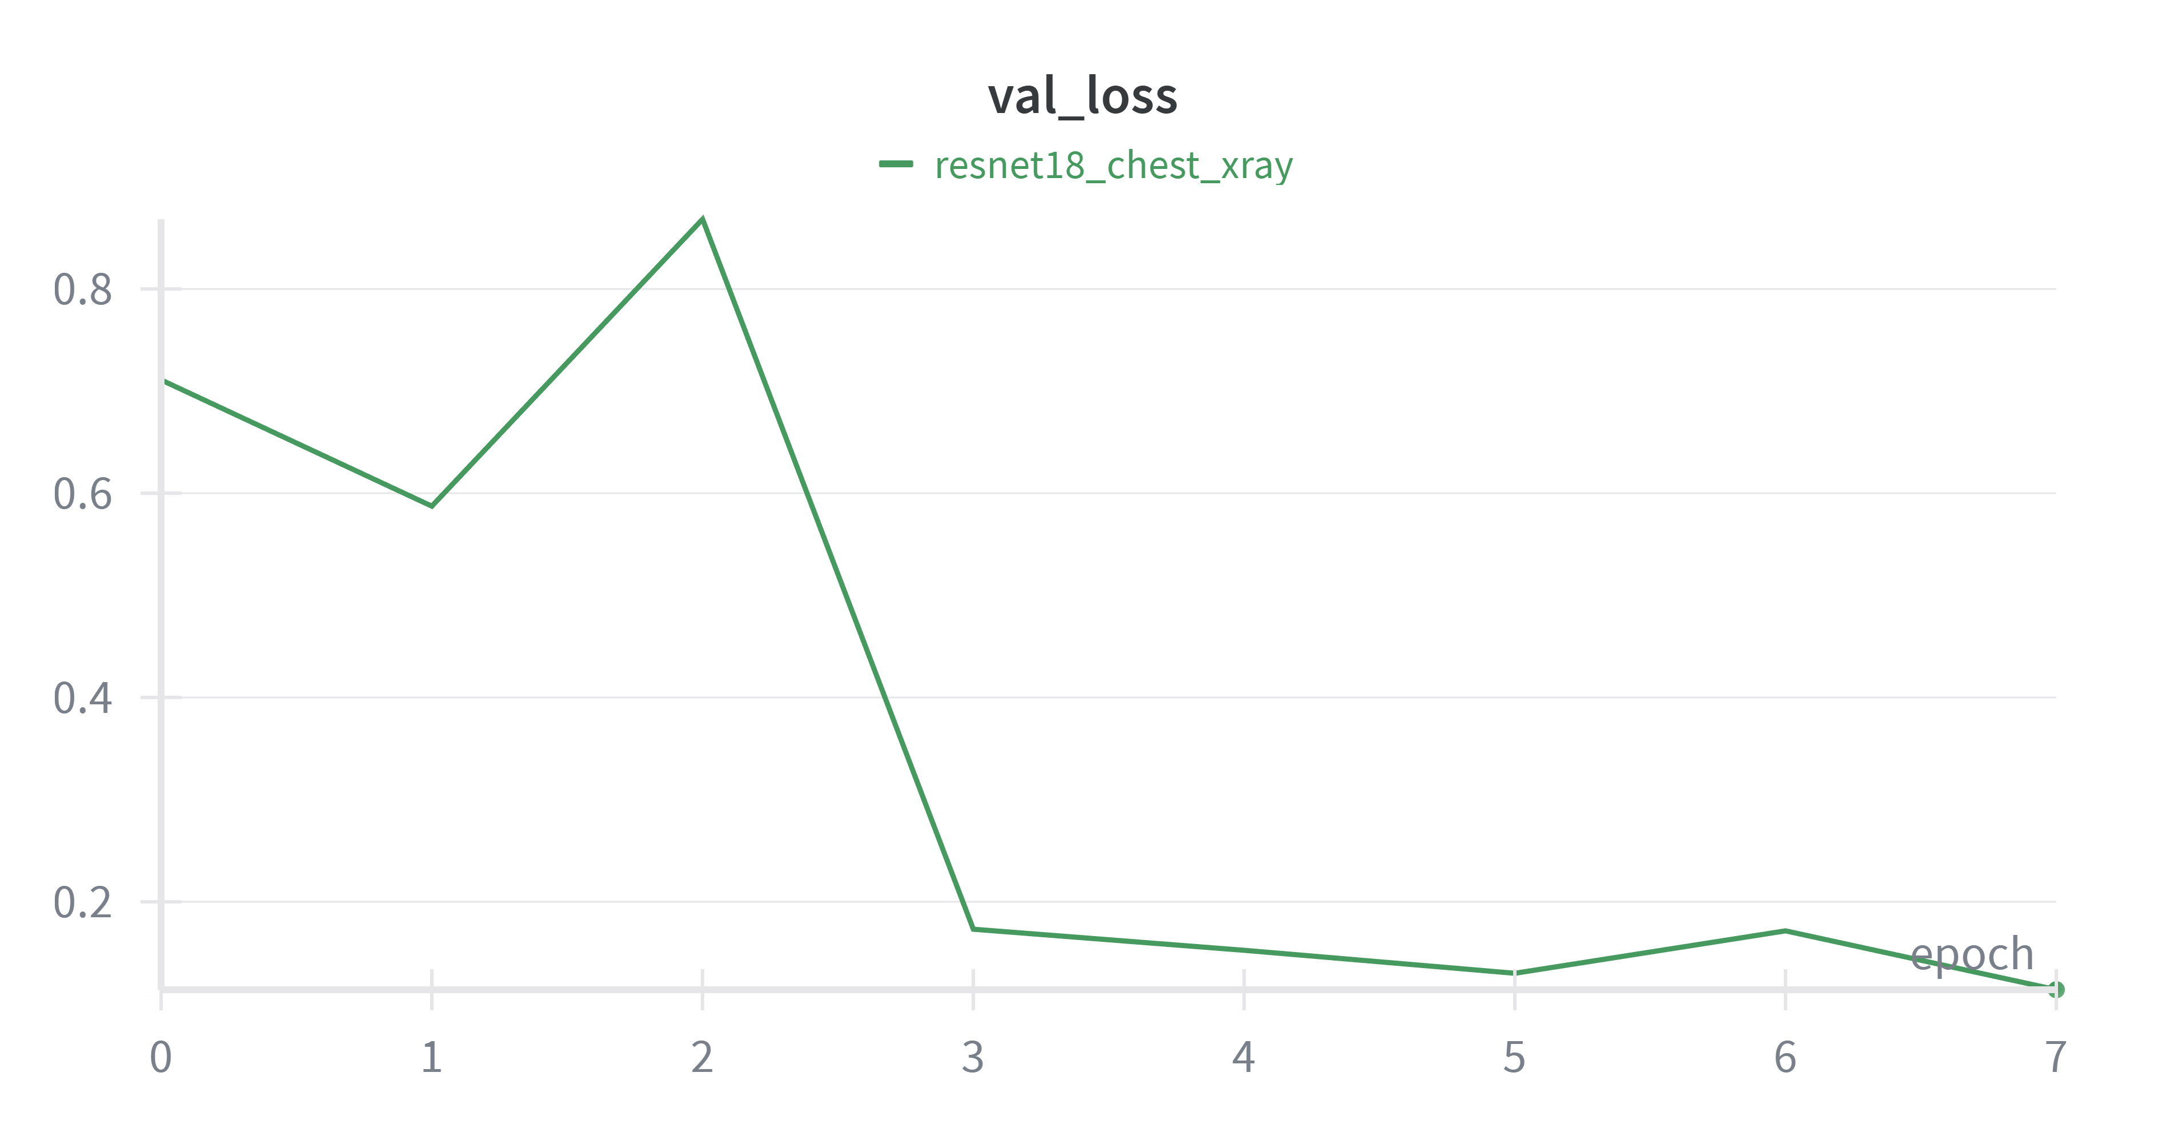
Stage Goal
Validation Phase Strategy
Focus: Generalization & Decision Making
Core Objective:
Evaluate Generalization Capability and detect Overfitting.
Key Actions:
Hyperparameter Tuning: Adjust Learning Rate based on validation plateaus.
Model Selection: Identify the "Best Weight" candidate.
Stop Conditions: Trigger Early Stopping if performance degrades or stagnates.

Slide 33
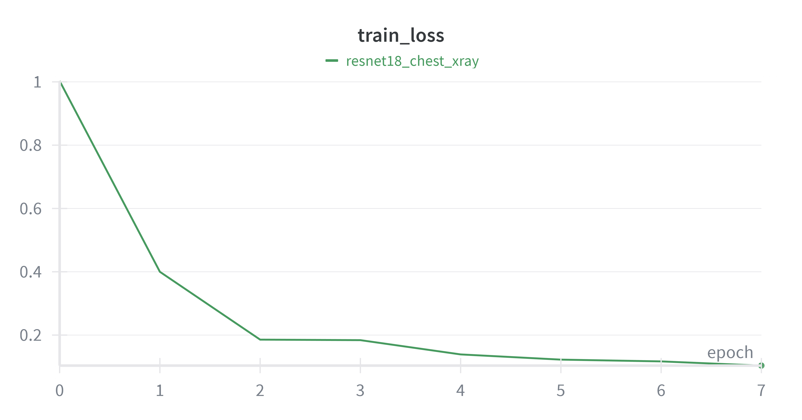
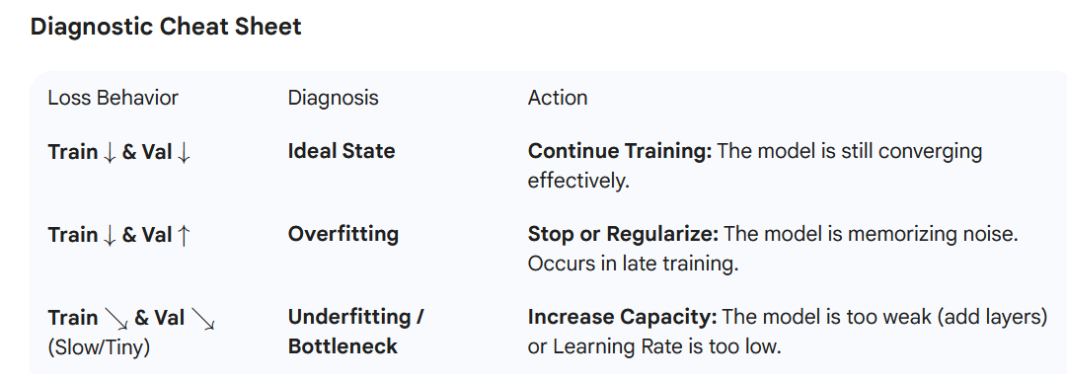
Stage Goal

Slide 34


Test Result
Metric Selection & Checkpointing
Focus: Business Alignment & Reliability
The North Star Metric (val_metric):
This is the critical business performance indicator.
Handling Class Imbalance:
Avoid Accuracy: It can be misleading in unbalanced datasets.
Adopt Robust Metrics: Prioritize val_f1 or val_recall to reflect true performance.
Checkpoint Strategy:
Best Model Selection: Save weights strictly based on val_f1 (or the specific target metric), not just the lowest loss.

Slide 35
This concludes my presentation. Thank you for listening.

